Slide 1



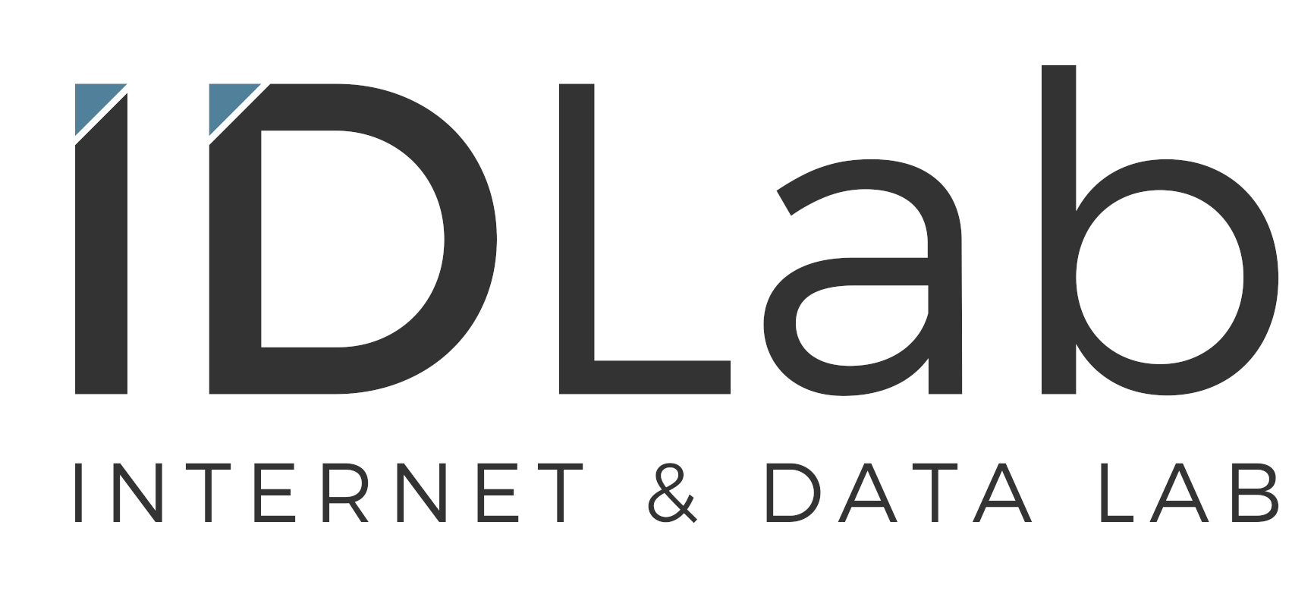
PErsoNal Genome QUery IN healthcare and clinical practice
PENGQUIN:
European Semantic Web Conference
Ph.D. Symposium (Early Stage)
May 27th, 2024
Elias Crum

Slide 2




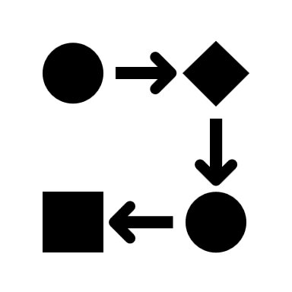
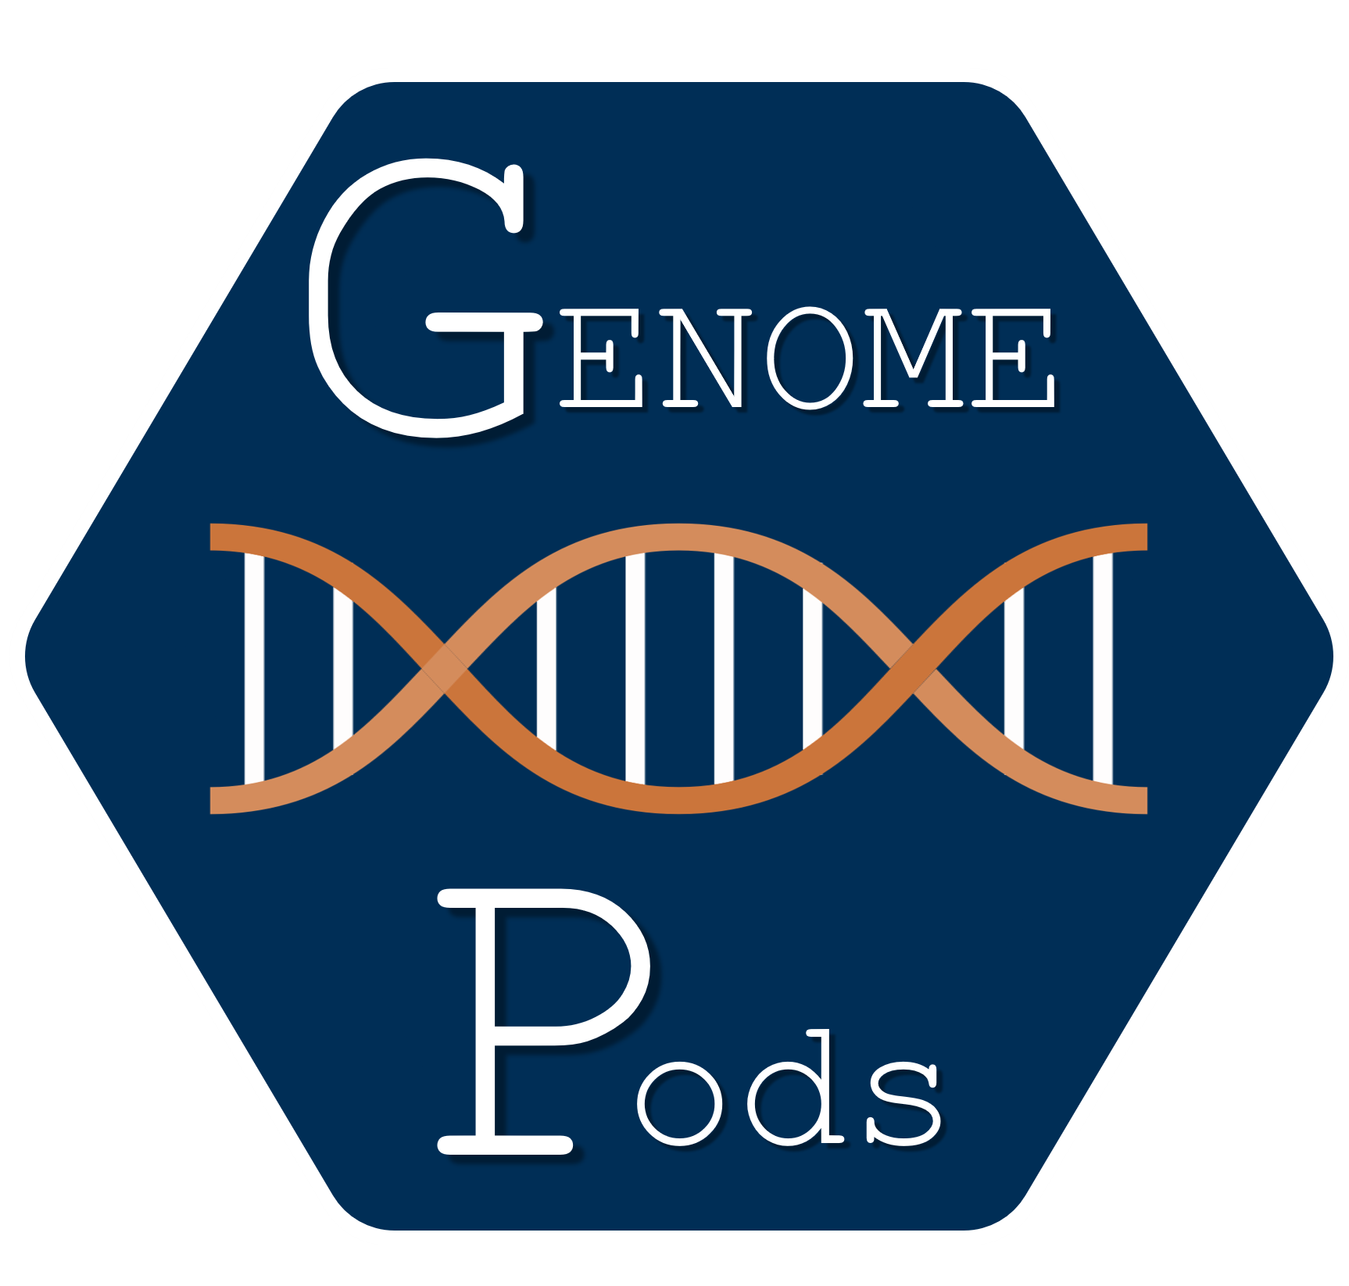
Outline
Why?
Genomic Data + Semanic Web?
Goals
Reshape how genomic data is stored
How?
Ph.D. plan introduction
Impacts
Deliverables and goals
1

Slide 3
PENGQUIN
PErsoNal Genome QUery IN healthcare and clinical practice
2

Slide 4

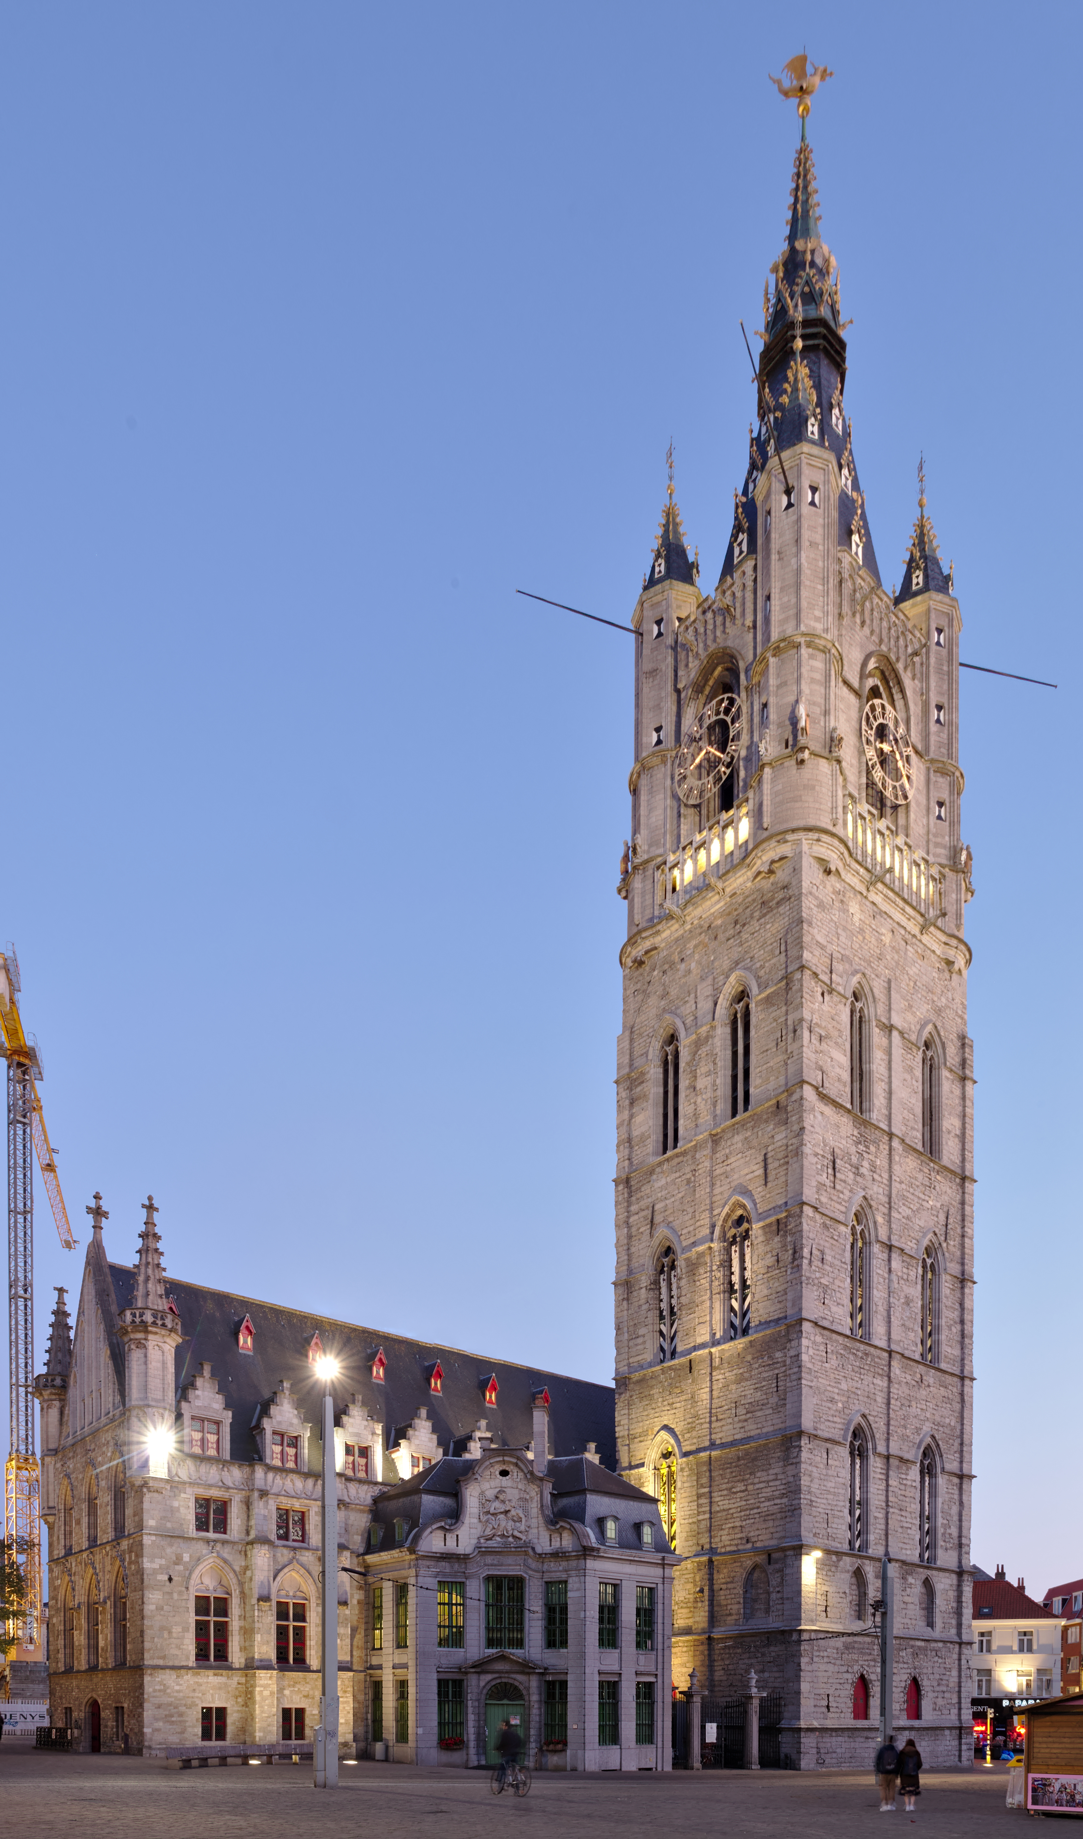



Personal Genome Sequence Data
Human genome data is big...
~3.2 BILLION base pairs ----> ~1 GB
Sequencing output file ----> ~200 GB
Ghent Belfry
Variant Call Format (VCF) file ----> ~200 MB
Individual humans exhibit ~3 million mutations
VCF file records only those differences
~91m
~130m
Other considerations
Storage
Privacy
Printed
Human Genome¹
Governance
Formatting
3
Bergström et al. SCIENCE 20 Mar 2020.

Slide 5
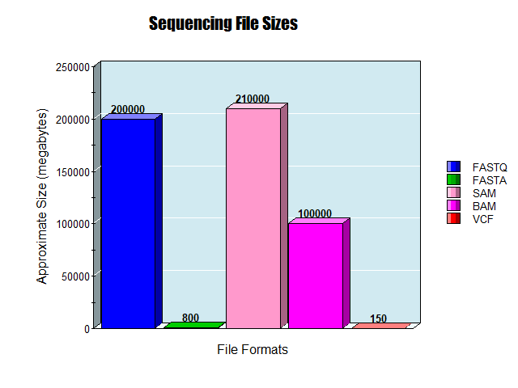
Sequence File Format Sizes
FASTQ
~ 200 gigabytes
(raw sequence output)
~ 800 megabytes
FASTA
(digital txt representation of genome)
~ 210/100 gigabytes
SAM/BAM
(intermediate between FASTA and FASTQ)
~ 150 megabytes
VCF
(just the mutations of an individual)
4
https://nces.ed.gov/

Slide 6








Genome Data in Health Care
Institution-centric
Data Storage
Technological
Infrastructure
?
&
Cloud
On-site
Data Usage
5
Notes:
Tec

Slide 7



Scaling Genome Data Usage
Research genomic data sharing initiatives:
State-of-the-art for clinical genomic data sharing?
GDPR (EU) / HIPPA (US) *EU Health Data Spaces*
Not much...
6

Slide 8

Solid Technology
Does not solve ALL problems, but offers an environment where improvements are possible
Easier sharing (web-facilitated)
Granular privacy controls
Direct patient data access
Data representation flexibility (RDF)
Possibility of data-linking and querying
https://solidproject.org/TR/protocol

Slide 9



Research Questions
1. Can Solid be implemented for genomic data storage?
What is the impact on data policy enforcement?
2. Can (VCF) genomic data be represented as RDF?
?
+
Can genomic and other medical data be linked semantically?
3. Can RDF genomic data be queried in a useful way?
Can this improve genomic data discoverability for researchers?
7

Slide 10


Project Goals
But wait...
This sounds like an ENGINEERING project!
Where is the RESEARCH?
9

Slide 11


(1a) Data Storage
1. Solid can be implemented for genomic data storage.
Solid pod instances
Community Solid Server⁴
VCF Genomic Data
Illumina Platinum Genomes⁵
Patient 1 Genome Data
VCF File
Data Ingestion
VCF File
Patient 1 Genome Pod
** What about data policy enforcement (privacy)?
10

Slide 12


(1b) Data Privacy Controls
1b. Granular privacy controls can be implemented in Solid² for genomic data.
Web Access Contol
???????
How granular can we make the privacy controls?
1b. Privacy controls at chromosome level, or even mutation level.
Chromosome is a semantic Class
VCF File
Mutation is also a semantic Class,
above a triple but below a Chromosome
Patient 1 Genome Pod
11

Slide 13

(2a) Genome Data in RDF
2a. VCF genomic data can be represented as RDF?
VCF to RDF Vocabularies exist
SPHN Semantic Interoperability Framework⁵
+ FHIR HL7 Format⁶
Keep VCF + RDF?
Utilize index for conversion?
Adapt vocabulary to a conversion workflow
Can RDF genomic data and other medical data be linked semantically?
12

Slide 14



(2b) RDF Genome Data Linking
2b. VCF genomic data can be Linked to other data.
Public Database
Test Results
VCF to RDF Vocabularies exist
Link parts of genome to medical data
How to automate this?
What vocabularies could be used for the linkages?
13

Slide 15





(3a) Querying Genome Pods
3a. RDF genomic data pods can be queried.
Query Engine
Custom Comunica implementation/engine⁶
“Do I have any patients with mutation Y .... ?”
“Do I have a mutation that impacts X .... ?”
“Are there patients here with mutation X that have consented to research access ... ?”
100s-1000s of Genome Pods
14

Slide 16







(3b) Querying Genome Pods (possibilities)
Single Pod Query
Utilizes an intra-pod index
Beacon API for Researcher Queries
Many Pod Query
Query is translated from Beacon API to Comunica
Then, the Many Pod query approach is followed
First, utilizes an extra-pod aggregator
Then, utilizes the intra-pod indexes
Aggregator
“Do I have any patients with mutation X .... ?”
index
Summary
Patient 1 Genome Pod
“Do I have a mutation that impacts X .... ?”
Patient 2 Genome Pod
Patient n Genome Pod
Query Engine
“Are there any patients with Z mutation .... ?”
index
index
15

Slide 17






PhD Goals
Finished
Soon
Basic Functionalities:
Future
Genomic data storage in Solid pods
Data privacy management
Data Sharing via the web
Experimental research:
Represent genomic data as RDF?
Linking genomic and health data?
Single and Many pod Querying?
16

Slide 18
Workflow Overview
Goal 1a
Goal 2a/b
Goal 1b
VCF File
Patient Genome Pods
VCF File
VCF File
Query Engine
Goal 3b
Goal 3a
17

Slide 19


Questions?
Paper
Contact

Slide 20
Thoughts about a solution
Large knowledge graph traversal is not a trivial querying problem
Current ideas for achieving “good” performance:
Genomic linked data structure leveraging
Gene locus / quality filtering / etc.
Search caching in query engine
Pre-computed summaries / indexes for more efficient data “location” determination

Slide 21
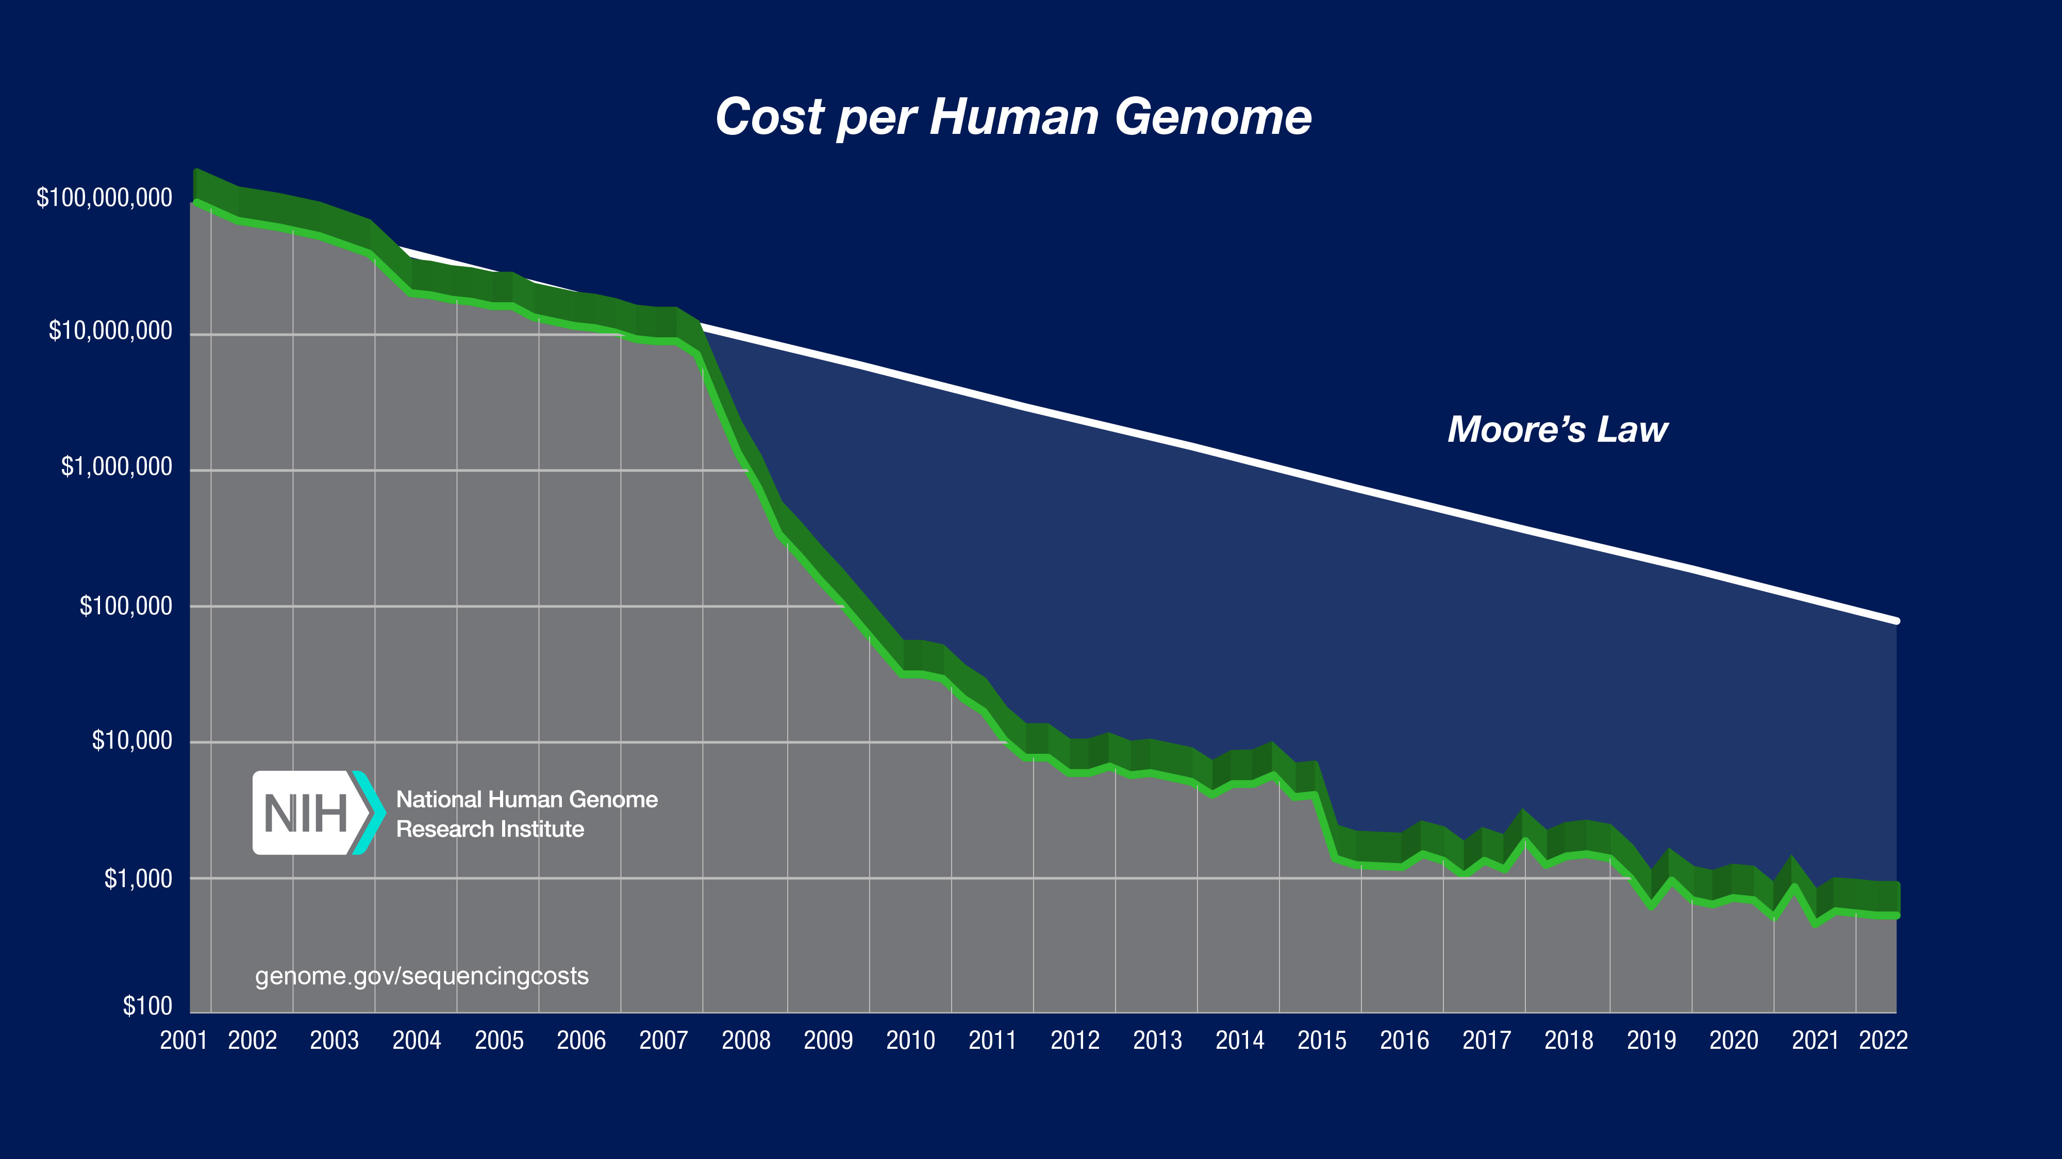
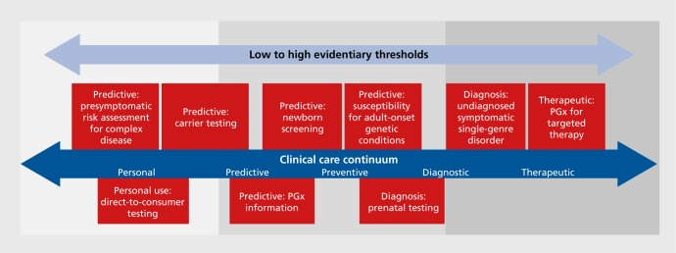
Genome Sequencing in Health Care
Sequence Generation Costs
Use-cases
10.31887/DCNS.2016.18.3/jkrier
Wetterstrand KA. Accessed 12/04/24.
Examples include:
Medication prescription (pharmacogenomics)
Genetic disease screening
Cancer diagnosis & treatment
Currently getting close to $100 per genome⁴
Per-base cost of sequencing has been dropping by half every ~5 months
Per-base cost of sequence data storage is dropping by half every ~14 months

Slide 22
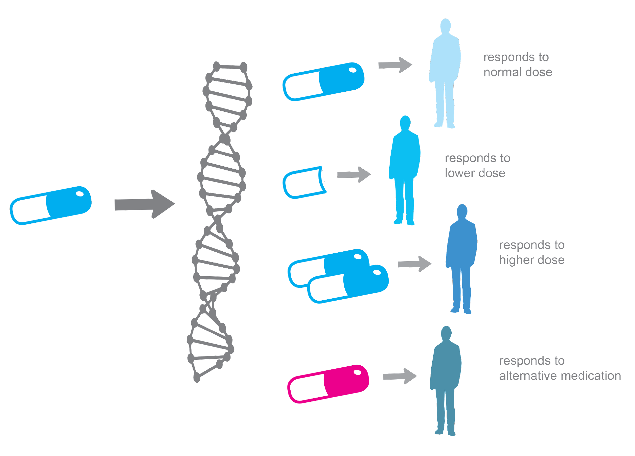
Personalized Medicine
All human diseases are influenced by genetics
Personalized Medicine = Medical care informed by an individual’s genetic profile
Examples:
Drug prescription
Cancer diagnosis
Cancer therapy development and targeting
Genetic disease screening
Jackson et al. Essays Biochem.3 Dec 2018.
https://alphagenomix.com/empowering-personalized-medicine/

Slide 23
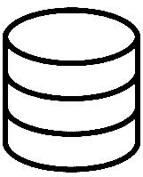

Sequencing and Storage Costs
By 2025, it is projected that human genome sequence storage will surpass cumulative data stored from social media platforms
<
Stevens et al. 2015. https://doi.org/10.1371/journal.pbio.1002195

Slide 24
Sequencing Storage
The human genome = ~3 billion base pairs
3 billion letters -- ~700 megabytes
Representative of a single strand of the whole human genome sequence
E.g. : …ATGCCGTAAACAGATGTCA …
Format: TXT file
Raw human whole genome sequence -- ~200 gigabytes
Whole genome sequences typically have >=30x coverage at each base position. (i.e. each base of the genome is represented in the sequence file a >= 30 times)
Format: FASTQ file
Aligned human whole genome sequence -- ~210 gigabytes // ~100 gigabytes // ~15 gigabytes
Whole genome sequence is mapped to a reference human genome and can be stored in various formats. Recent advances have allowed for improved compression.
Format: SAM file // BAM file // CRAM file
Human genome variant file (list of mutations) -- ~125 megabytes
Individual humans only exhibit ~0.1% variation comparatively (~3 million mutations). Variant file records those differences in one individual’s genome compared to the “normal” reference genome.
Format: VCF file

Slide 25
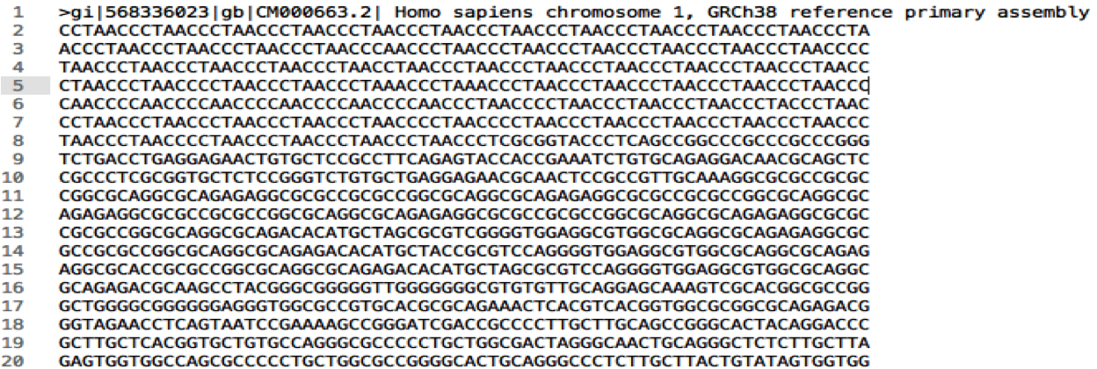
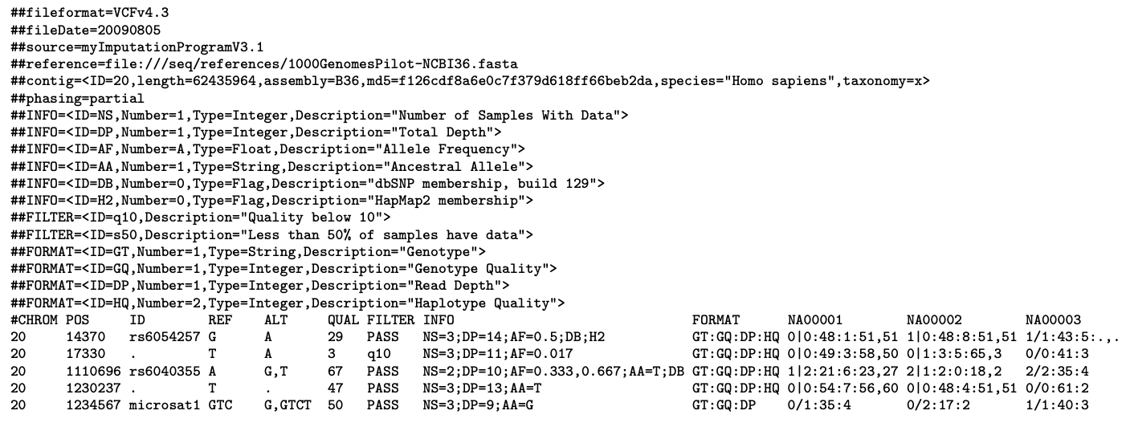
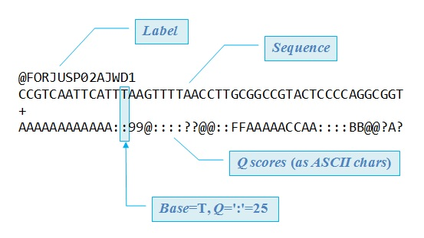
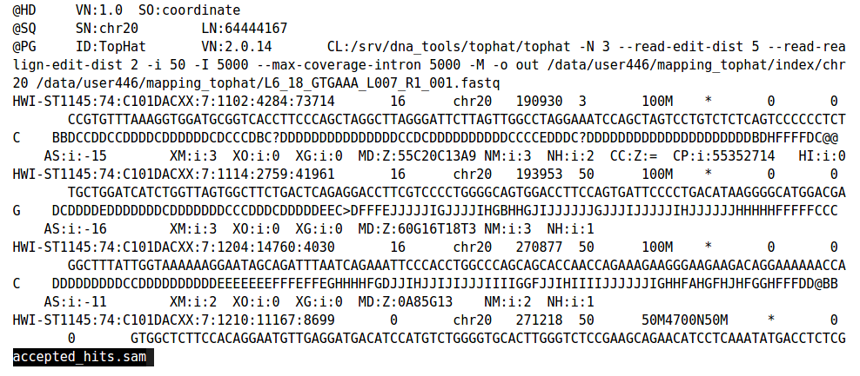
Sequence Data Formats
FASTQ
FASTA
SAM/BAM
VCF
Raw Sequencing Outputs
Contiguous DNA sequence
FASTQ reads aligned to a FASTA reference
Areas in SAM where sample and reference differ

Slide 26
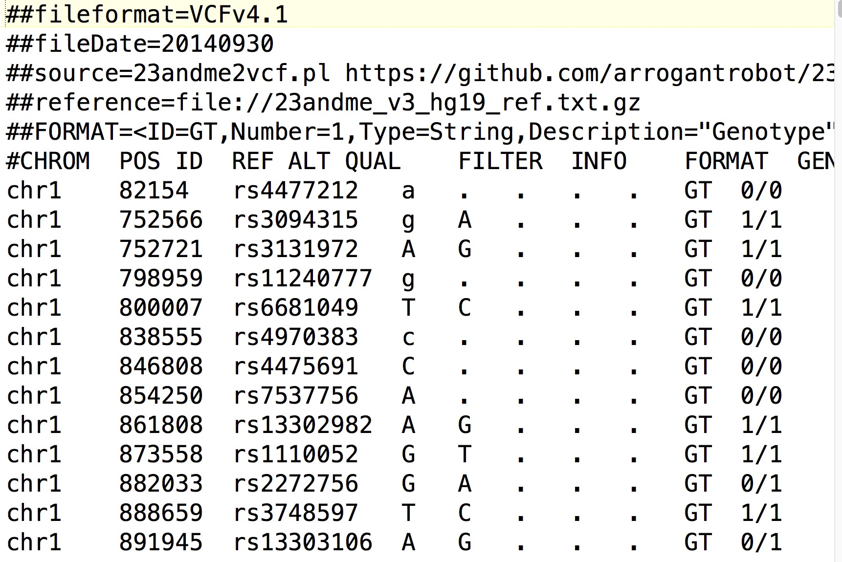
Variant Call Format (VCF)
- tab delimited .txt file
- Rows represent individual mutations in a sequence (when compared to reference)
- Columns store information about that mutation

Slide 27
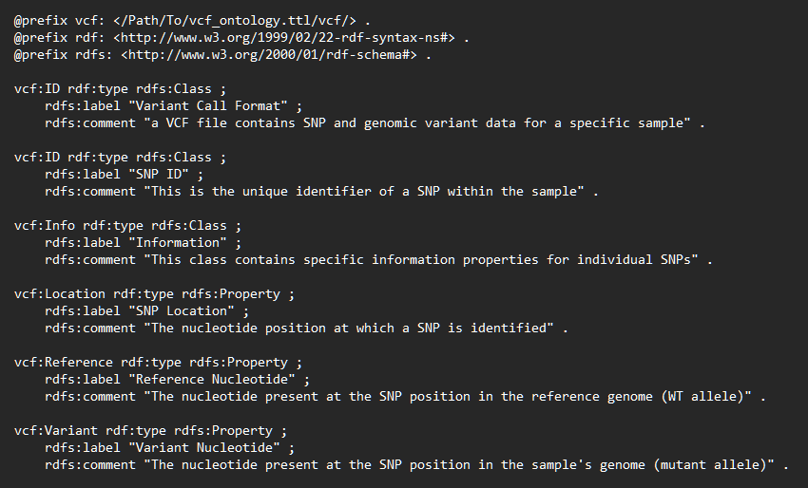
Ontology Definition
Predicate
Subject
Object
Resource Description Format (RDF):
Allele
Gene_A1
“C”
Defining an ontology:

Slide 28
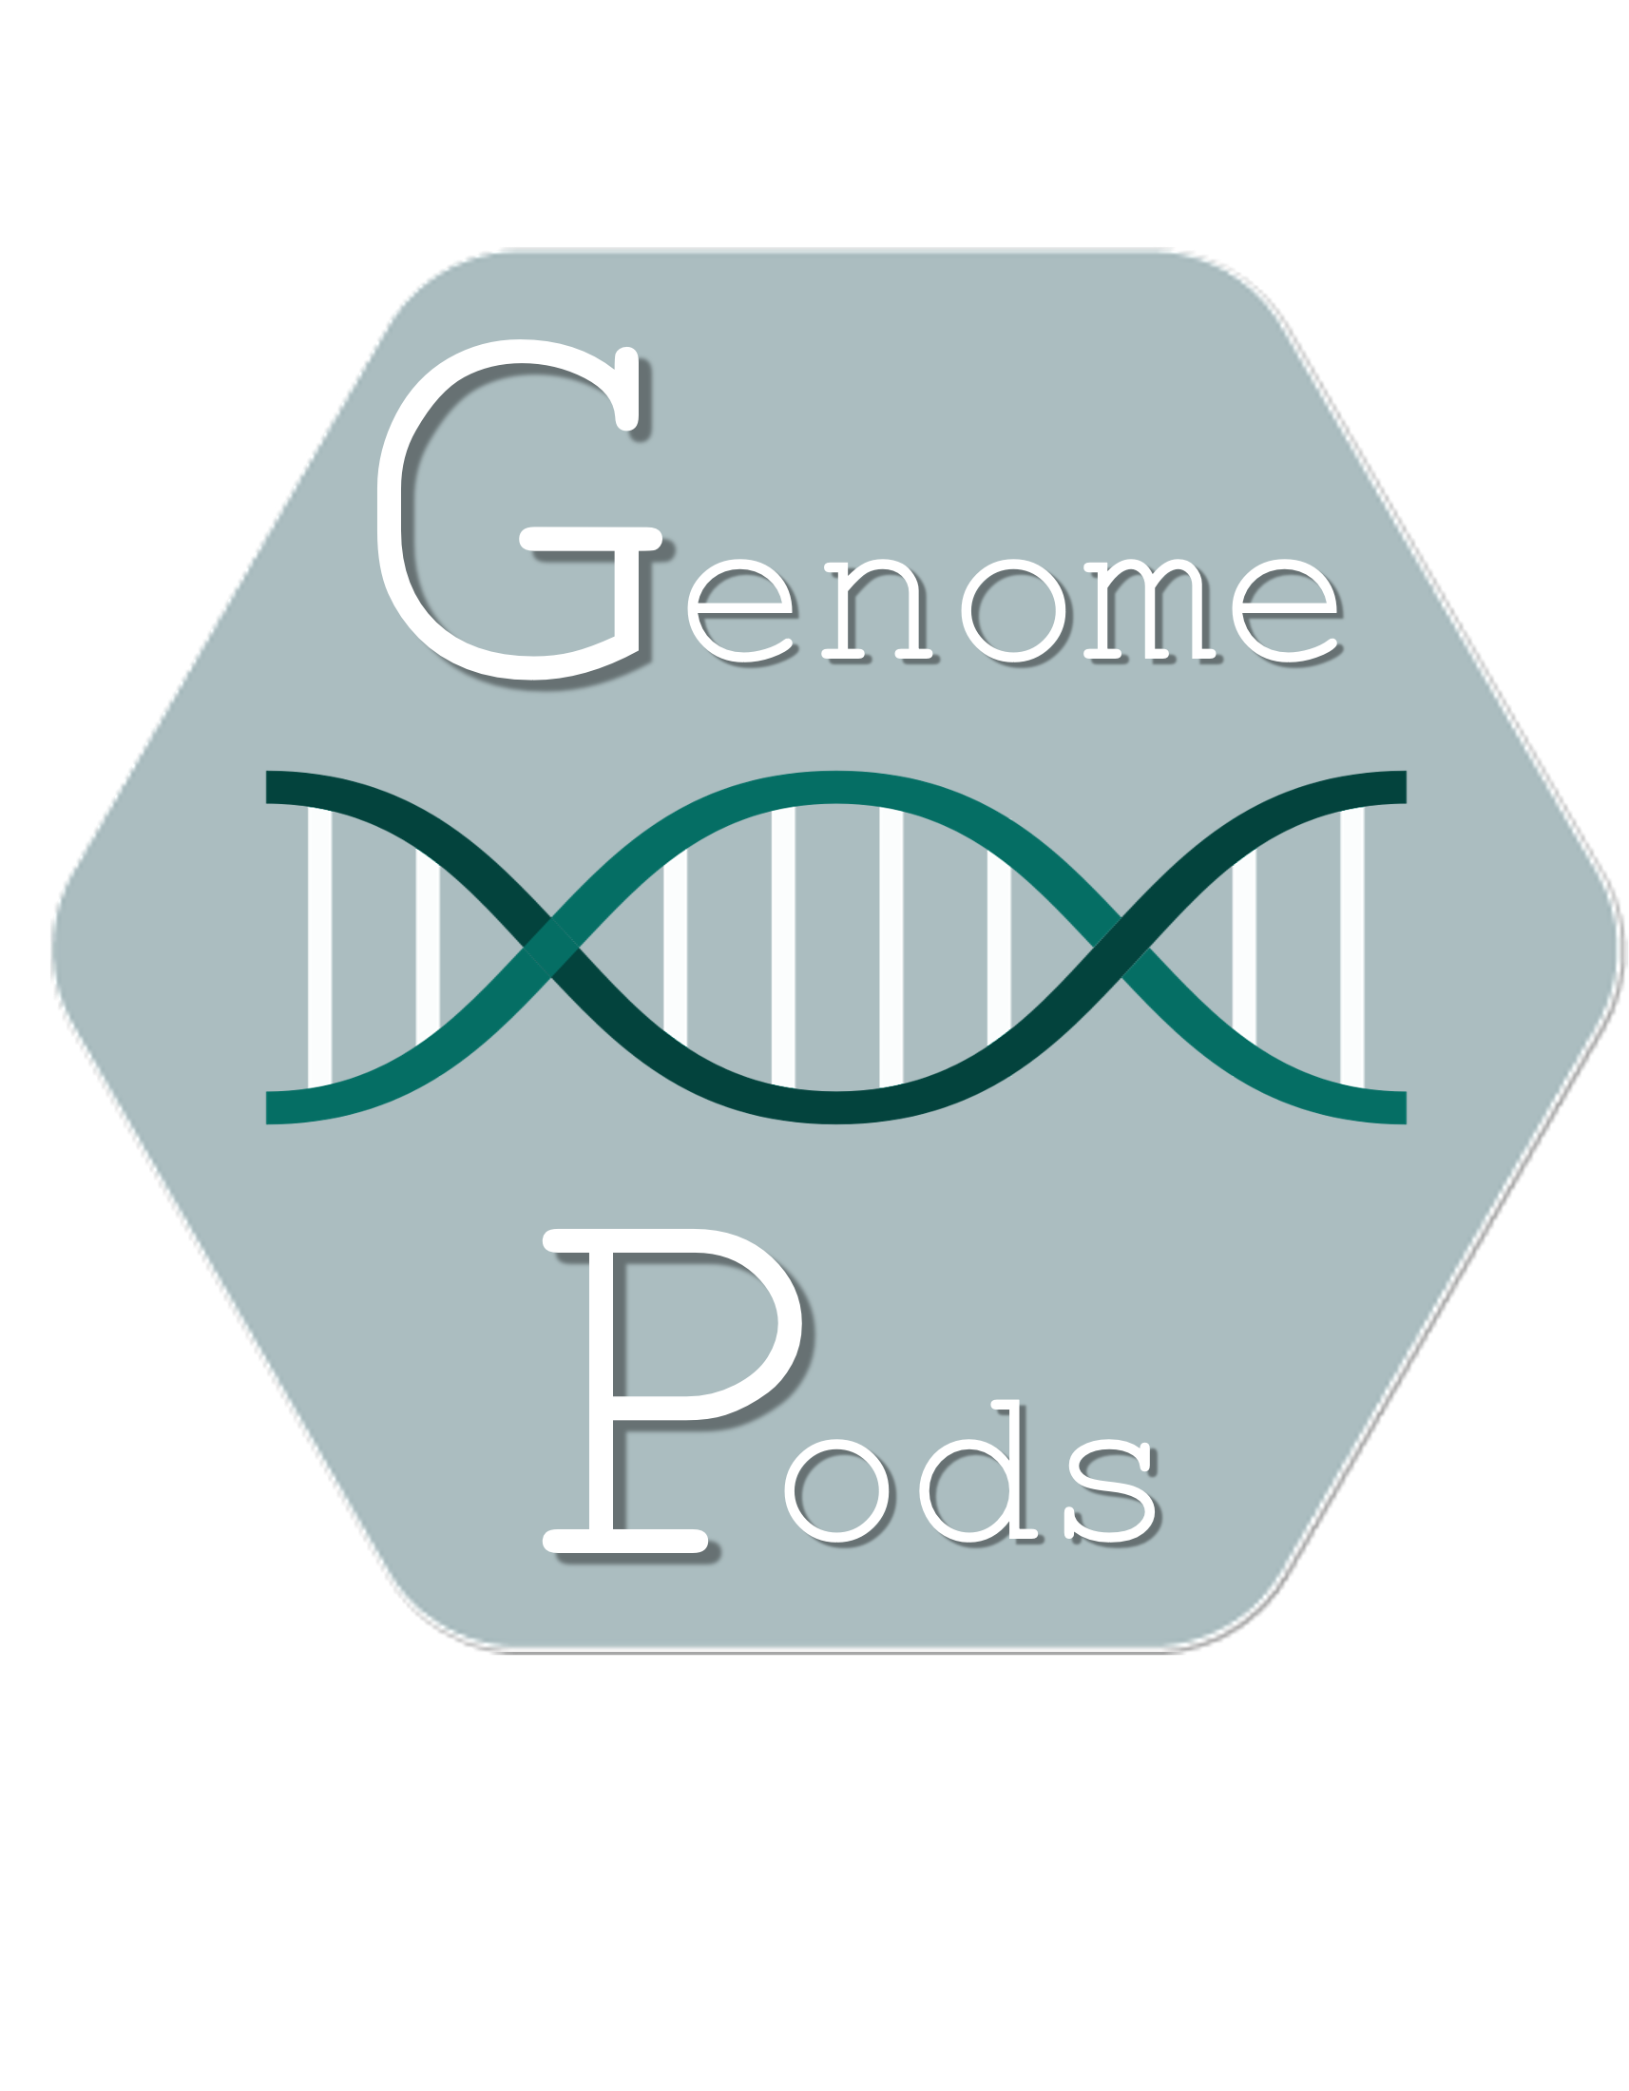
Project Goals
To develop a proof-of-concept framework for:
Genomic data storage in Solid Pods
Granular privacy controls of genomic data
Genomic data representation in RDF
Data-linking with medically-relevant data
Data querying potential (within and across pods)
8

Slide 29
Implementation Specifics
Solid pod instances
Community Solid Server⁴
Genomic Data
Publicly available VCF data⁴
RDF Conversion
Aim to use SPHN RDF vocabulary⁵
Data-linking
Actively exploring ontologies / methodologies
Data Querying
Custom instance of Comunica⁶

Slide 30
Sources
https://bio4.us/biotrends/human_genome_height.html
Tse, G. et al. Genotype‐guided warfarin dosing vs. conventional dosing strategies: a systematic review and meta‐analysis of randomized controlled trials. 2018. https://doi.org/10.1111%2Fbcp.13621
Wetterstrand KA. DNA Sequencing Costs: Data from the NHGRI Genome Sequencing Program (GSP) www.genome.gov/sequencingcostsdata. Accessed 12/04/24.
https://www.ultimagenomics.com/publications-and-resources?filter=Literature
van der Horst E, et al. Bridging Clinical and Genomic Knowledge: An Extension of the SPHN RDF Schema for Seamless Integration and FAIRification of Omics Data. 2023. https://doi.org/10.20944/preprints202312.0373.v1
Dolin RH, et al. vcf2fhir: a utility to convert VCF files into HL7 FHIR format for genomics-EHR integration. 2021 Mar. doi: 10.1186/s12859-021-04039-1.

Slide 31
Sources
Slide 6 (Sequencing Storage):
Cock, P. J. A., Fields, C. J., Goto, N., Heuer, M. L. & Rice, P. M. The Sanger FASTQ file format for sequences with quality scores, and the Solexa/Illumina FASTQ variants. Nucleic Acids Res 38, 1767–1771 (2010).
Li, H. et al. The Sequence Alignment/Map format and SAMtools. Bioinformatics 25, 2078–2079 (2009).
Bonfield, J. K. CRAM 3.1: advances in the CRAM file format. Bioinformatics 38, 1497–1503 (2022).
Danecek, P. et al. The variant call format and VCFtools. Bioinformatics 27, 2156–2158 (2011).

